Slide 1
Team 7 Text Sentiment Analysis
Team Members: Ross Kugler, Jason Eigeman, Justin Lawrence, Audrey Lindstrom, Linh (Jason) Nguyen, Huy (Harry) Ky

Slide 2
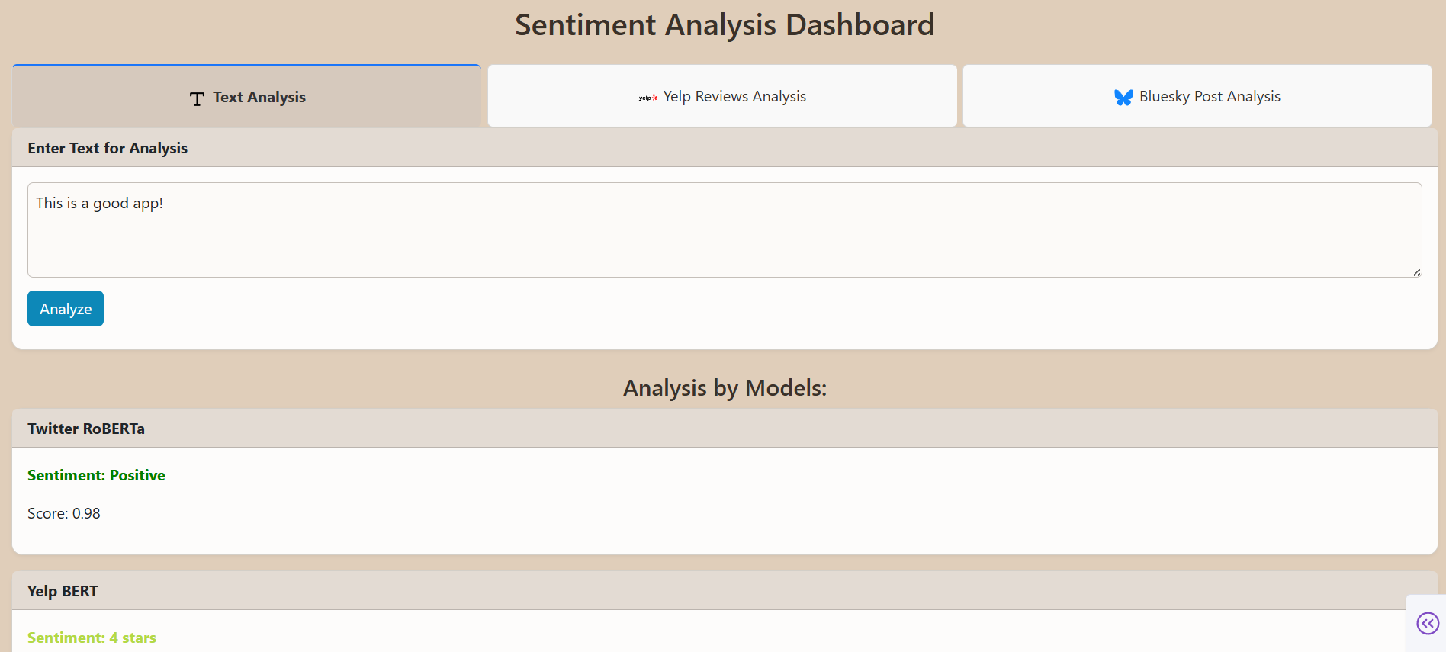
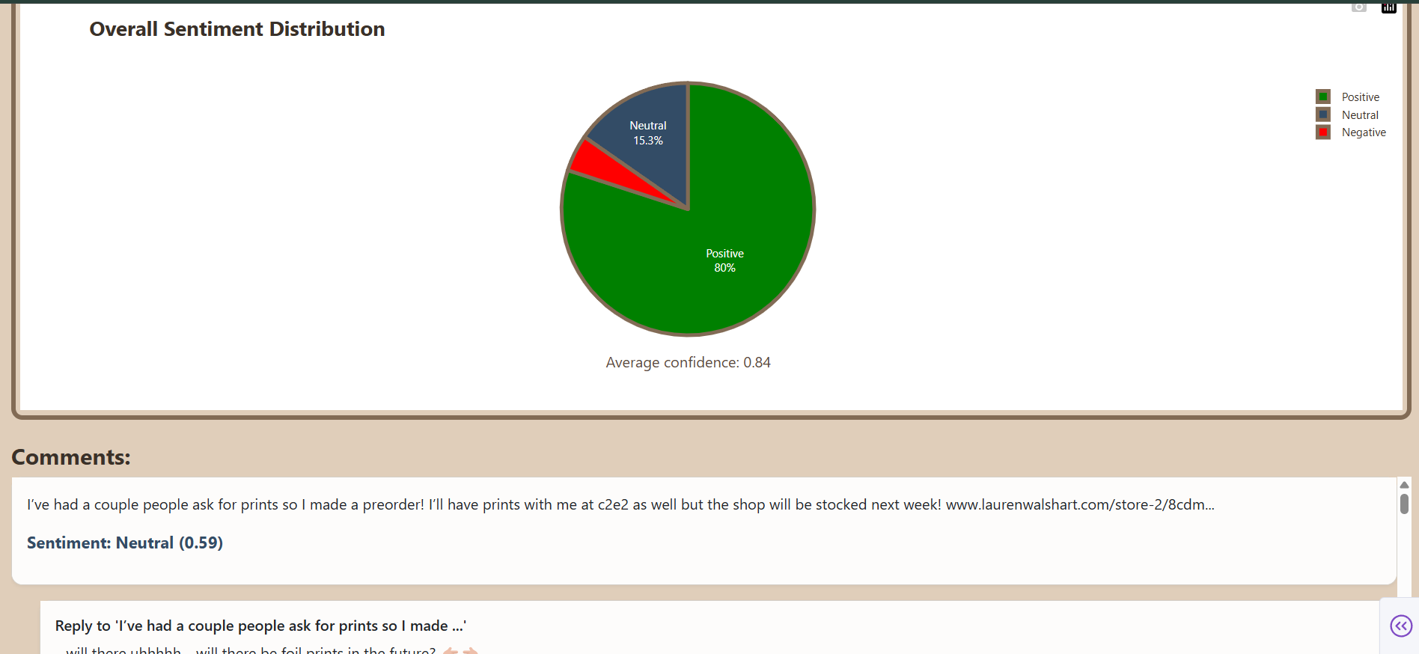
Project Overview
Problem: How to analyze and classify the overall sentiment of text comments/reviews?
Solution: Web app that utilizes AI models trained on text sentiment analysis to provide insights

Slide 3
Datasets
For Training:
GoEmotions
human-annotated emotion data
dominant heuristic uses emotion-related Twitter tags
For Testing/Using with our Models:
Yelp Academic Dataset
Bluesky API

Slide 4
Models
T5Emotions (custom model, fine-tuned on GoEmotions dataset)
Twitter RoBERTa (pretrained, from HuggingFace)
Yelp BERT (pretrained, from HuggingFace)

Slide 5
Model | Base Architecture | Dataset Source | Task Type | Output Format
GoEmotions | BERT-base | Reddit comments | Multi-label classification | List of emotions
T5Emotions | T5 (text-to-text) | GoEmotions | Text generation (emotions) | Generated label text
Twitter RoBERTa | RoBERTa-base | Twitter data | Classification | Single/multi emotion
Yelp BERT | BERT-base | Yelp reviews | Sentiment classification | Star rating or emotion

Slide 6
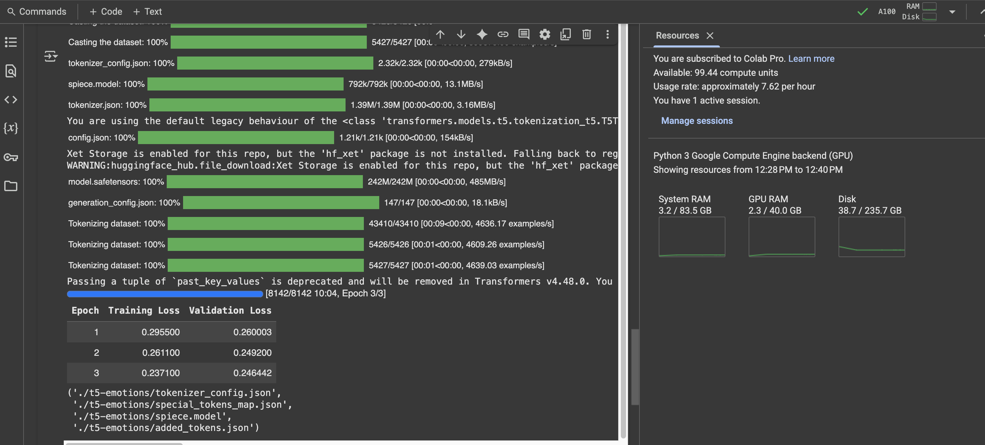
Fine-Tuning T5 with GoEmotions Dataset
We utilized Google Colab Pro to access A100 to effectively train the model.
With each epoch, both the training and validation loss consistently decreased, indicating that the model was effectively learning from the training data and improving its performance over time.

Slide 7
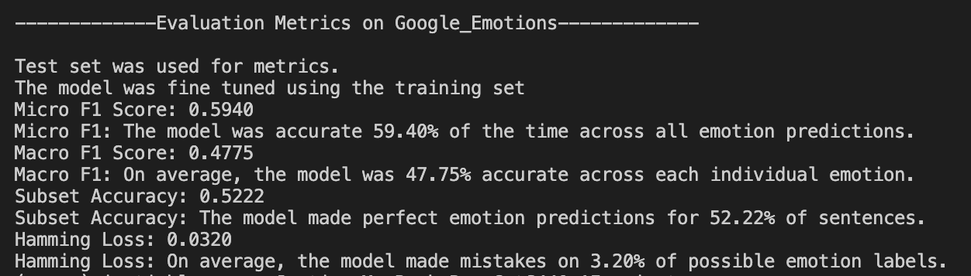
Fine-Tuned T5 Metrics
Utilized GoEmotions Test data to run metrics on how well the model learned from the training data.
Micro F1 Score: Measures the model’s overall ability to correctly predict all emotions. Higher is better.
Macro F1 Score: Averages the model’s performance on each individual emotion. Higher is better.
Subset Accuracy: Calculates how often the model predicts all the correct emotions for a sentence with no mistakes. Higher is better.
Hamming Loss: Shows the percentage of individual label predictions the model got wrong. Lower is better

Slide 8
Evaluation

Slide 9
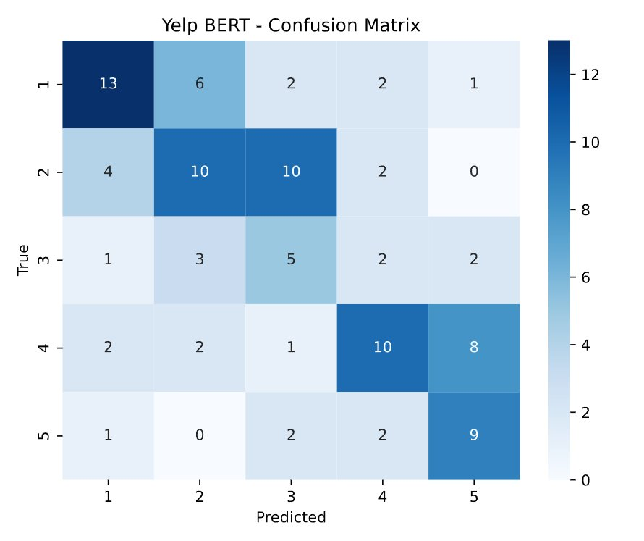
Evaluation

Slide 10
Project Difficulties
Data Quality
Typos, Negations, and Sarcasm
Combining and Normalizing different datasets
Time-Constraints (would improve UI, more time to train models)
Notes:
Adversarial Testing
data is often unstructured and informal, containing slang, abbreviations, sarcasm, and cultural nuances that challenge traditional sentiment classification systems.
During our project we noticed a
Combining and Normalizing different datasets
Inconsistent annotations made combining datasets more complex than expected.
Finding common multiclass labels is time intensive which caused us to stick with more binary labels such as positive and negative
Dealing with data from different origins such as yelp and twitter didn’t mix well

